Slide 1
Lottery Myths Busted
The Truth about winning numbers
Alex Spence
DSC 640 Week 7 & 8

Slide 2
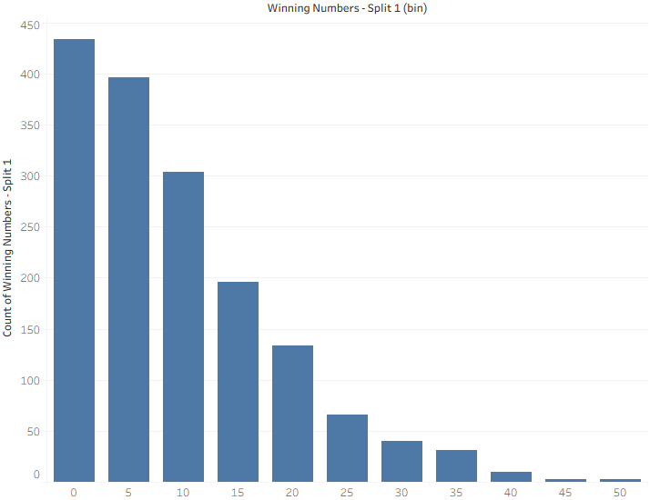
Powerball Frequency
Numbers are random

Slide 3
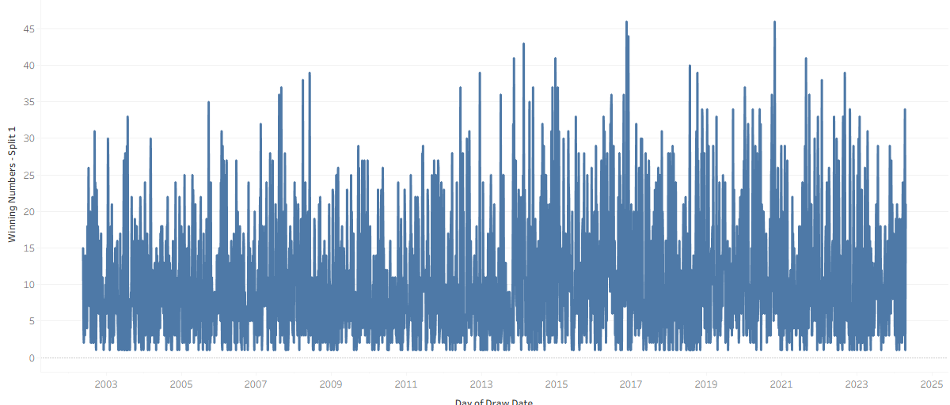
Mega Millions Density
Reinforce randomness across lotteries.

Slide 4
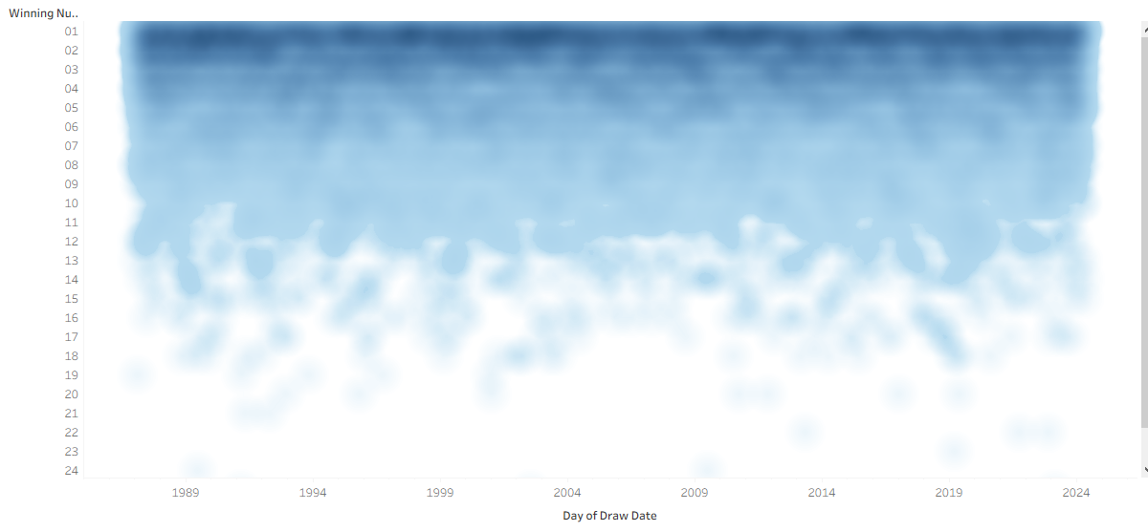
Pick 10 Scatter
Highlight lack of patterns over time.

Slide 5
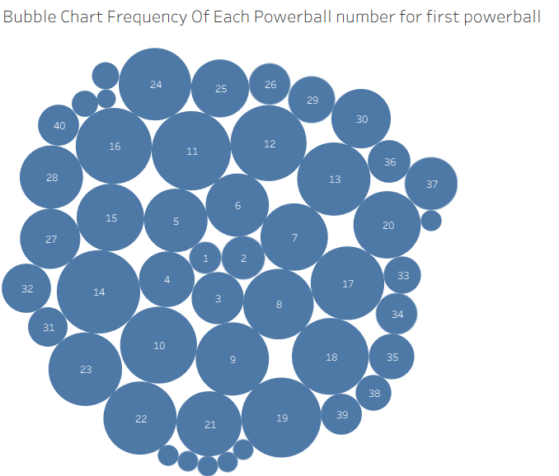
Powerball Bubble Chart
Visually show frequency equality.

Slide 6
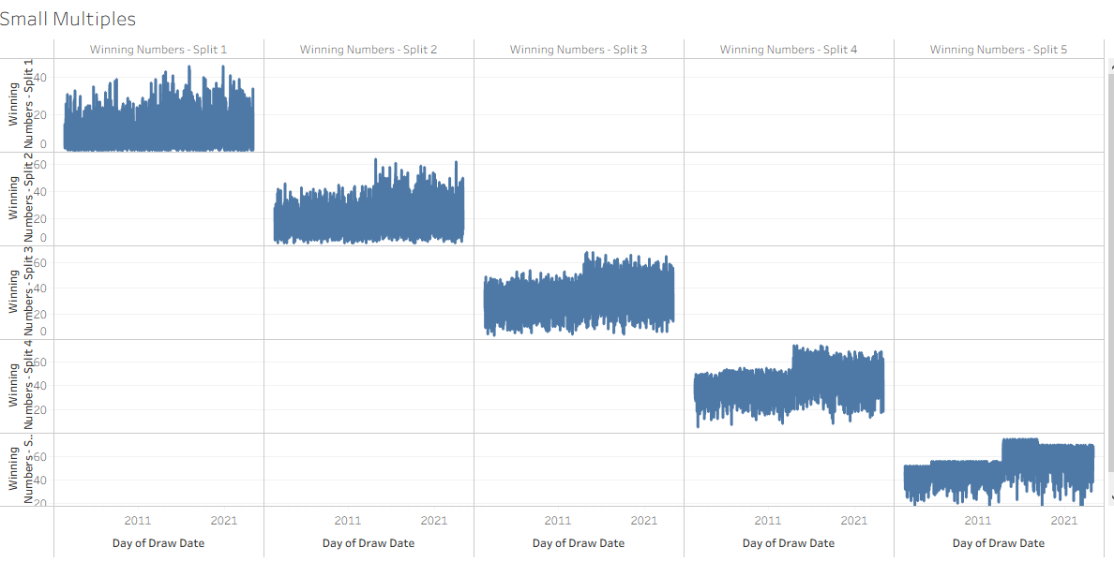
Lottery Small Multiples
Compare randomness across balls.

Slide 7
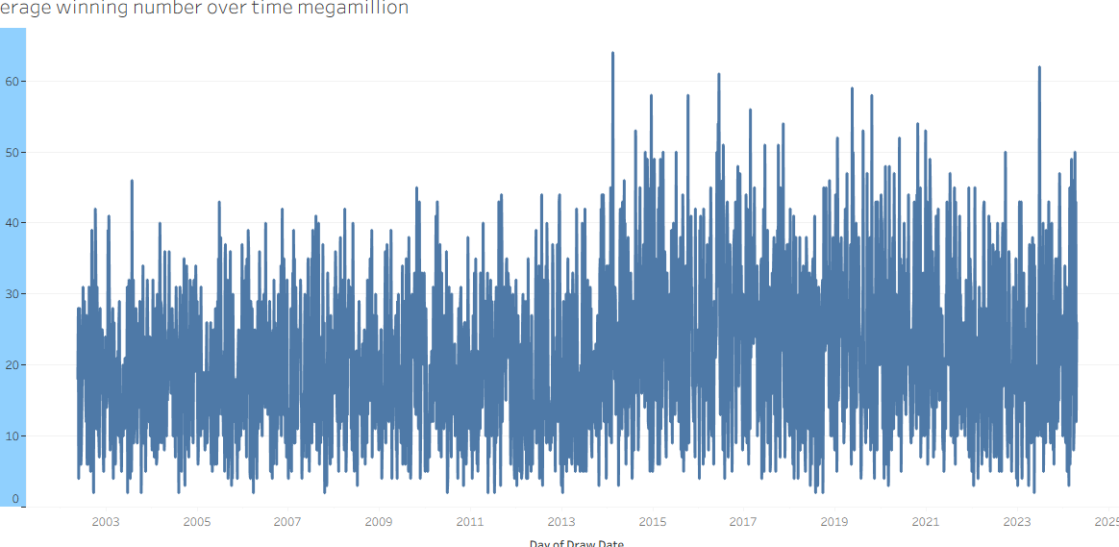
Average Mega Millions Number Over Time
Random over time

Slide 8
Call to Action
Play for fun, not fortune. Donate winnings to charity or save—visit gamblinghelp.org for tips!

